Slide 1


WAVELET TRANSFORM
Supervisor: Dr. Lý Quốc Ngọc
Group 9: Hồ Quang Minh - 1211042
Đỗ Đặng Minh - 1311015
Huỳnh Công Toàn - 1311026
Dương Xuân Long - 1311048
Hồ Văn Tấn - 1311058
Notes:
Version: 1.0
Last update: September 25, 2014

Slide 2
OUTLINE
Fourier Transform
Wavelet Transform
Continuous Wavelet Transform
Multiresolution Analysis
Discreet Wavelet Transform
2D Wavelet Transform
Fast Wavelet Transform
Wavelet Packet
Wavelet Transform Application
Demo

Slide 3
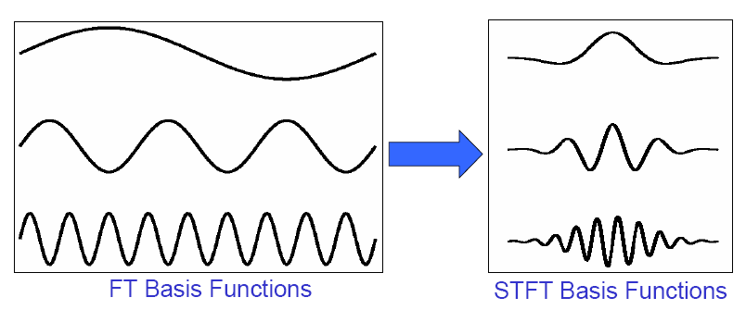
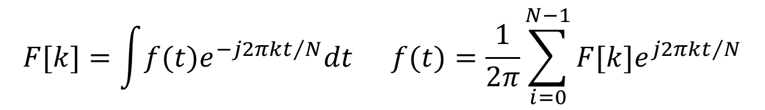
FOURIER TRANSFORM
Frequency domain: Joseph Fourier (1807).
Cannot provide simultaneously time and frequency information.
$$F[k]=\int{f(t)e^{−j2πkt/N}dt} f(t)=\frac{1}{2π}\sum_{i=0}^{N−1}{F[k]e^{j2πkt/N}}$$
Notes:
Transform: A mathematical operation that takes a function or sequence and maps it into another one
The transform of a function may give additional /hidden information about the original function, which may not be available/obvious otherwise
The transform of an equation may be easier to solve than the original equation
The transform of a function/sequence may require less storage, hence provide data compression / reduction
An operation may be easier to apply on the transformed function, rather than the original function (recall convolution)

Slide 4

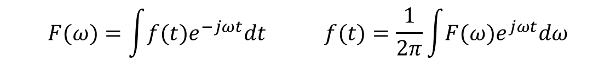
FOURIER TRANSFORM
Recall that FT uses complex exponentials (sinusoids) as building blocks.
For each frequency of complex exponential, the sinusoid at that frequency is compared to the signal.
If the signal consists of that frequency, the correlation is high → large FT coefficients.
If the signal does not have any spectral component at a frequency, the correlation at that frequency is low / zero, → small / zero FT coefficient.
$$e^{jωt}=cos\left(ωt\right)+jsin\left(ωt\right)$$
$$F(ω)=\int{f(t)e^{−jωt}dt} f(t)=\frac{1}{2π}\int{F(ω)e^{jωt}dω}$$

Slide 5
Stationary and Non-stationary Signals
FT identifies all spectral components present in the signal, however it does not provide any information regarding the temporal (time) localization of these components. Why?
Stationary signals consist of spectral components that do not change in time
all spectral components exist at all times
no need to know any time information
FT works well for stationary signals
However, non-stationary signals consists of time varying spectral components
How do we find out which spectral component appears when?
FT only provides what spectral components exist , not where in time they are located.
Need some other ways to determine time localization of spectral components

Slide 6
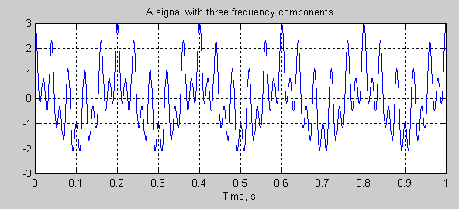
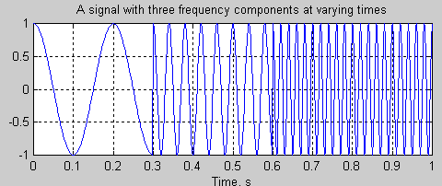
Stationary and Non-stationary Signals
Stationary signals’ spectral characteristics do not change with time
Non-stationary signals have time varying spectra
Concatenation

Slide 7

SHORT-TIME FOURIER TRANSFORM
Time-Frequency analysis: STFT (Dennis Gabor 1946).
$$STFT\left\{x\left(t\right)\right\}\left\{τ,ω\right\}≡X\left(τ,ω\right)=\int_{−∞}^{∞}{x(t)ω\left(t−τ\right)e^{−jωt}dt}$$
Time
parameter
Frequency
parameter
Signal to
be analyzed
FT Kernel
(basis function)
STFT of signal x(t):
Computed for each
window centered at t=t’
Windowing
function
Windowing function
centered at t=t’
Notes:
Choose a window function of finite length
Put the window on top of the signal at t=0
Truncate the signal using this window
Compute the FT of the truncated signal, save.
Slide the window to the right by a small amount
Go to step 3, until window reaches the end of the signal
For each time location where the window is centered, we obtain a different FT
Hence, each FT provides the spectral information of a separate time-slice of the signal, providing simultaneous time and frequency information

Slide 8
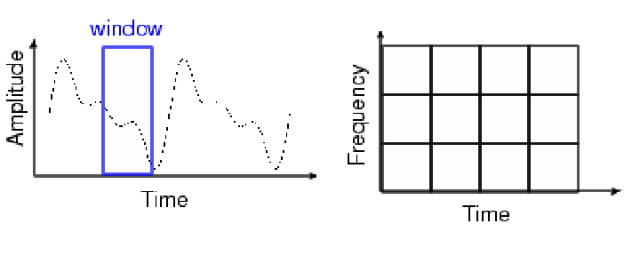
SHORT-TIME FOURIER TRANSFORM
Wide analysis window ➔ poor time resolution, good frequency resolution.
Narrow analysis window ➔ good time resolution, poor frequency resolution
Once the window is chosen, the resolution is set for both time and frequency.
Notes:
Choose a window function of finite length
Put the window on top of the signal at t=0
Truncate the signal using this window
Compute the FT of the truncated signal, save.
Slide the window to the right by a small amount
Go to step 3, until window reaches the end of the signal
For each time location where the window is centered, we obtain a different FT
Hence, each FT provides the spectral information of a separate time-slice of the signal, providing simultaneous time and frequency information

Slide 9
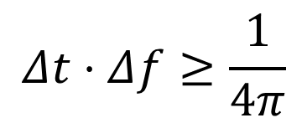
Heisenberg Uncertainty Principle
$$Δt⋅Δf≥\frac{1}{4π}$$
Time resolution: How well two spikes in time can be separated from each other in the transform domain
Frequency resolution: How well two spectral components can be separated from each other in the transform domain
Both time and frequency resolutions cannot be arbitrarily high!!! ➔ ➔We cannot precisely know at what time instance a frequency component is located. We can only know what interval of frequencies are present in which time intervals

Slide 10
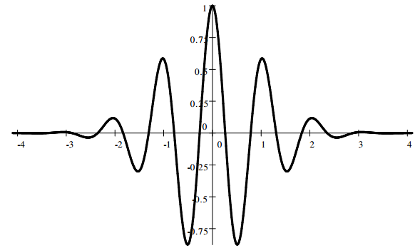
WAVELET TRANSFORM
Decomposition of a signal into constituent parts.
Notes:
Fourier series: harmonic sinusoids; single integer index
Fourier transform (FT): nonharmonic sinusoids; single real index
Walsh decomposition: “harmonic” square waves; single integer index
Karhunen-Loeve decomp: eigenfunctions of covariance; single real index
Short-Time FT (STFT): windowed, nonharmonic sinusoids; double index
Wavelet Transform: time-compacted waves; double index

Slide 11
WAVELET TRANSFORM
Overcomes the preset resolution problem of the STFT by using a variable length window
Analysis windows of different lengths are used for different frequencies:
Analysis of high frequencies➔ Use narrower windows for better time resolution
Analysis of low frequencies ➔ Use wider windows for better frequency resolution
This works well, if the signal to be analyzed mainly consists of slowly varying characteristics with occasional short high frequency bursts.
Heisenberg principle still holds!!!
The function used to window the signal is called the wavelet

Slide 12
WAVELET TRANSFORM
Wavelet transform also provides time-frequency view
Decomposes signal in terms of duration-limited, band-pass components
high-frequency components are short-duration, wide-band
low-frequency components are longer-duration, narrow-band
Can provide combo of good time-frequency localization and orthogonality
the STFT can’t do this
More precisely, wavelets give time-scale viewpoint
this is connected to the multi-resolution viewpoint of wavelets

Slide 13
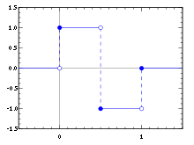
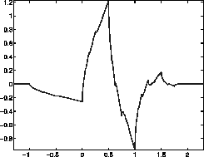
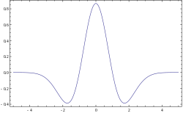
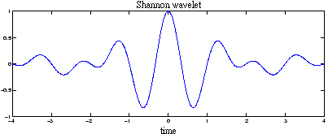
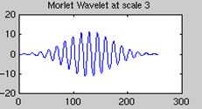
TYPES OF WAVELET
Daubechies
Haar
Mexican hat
Shannon
Morlet

Slide 14
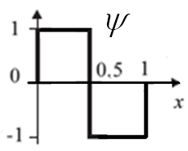
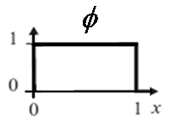

TYPES OF WAVELET
Haar wavelet:
Wavelet function
$$ψ\left(t\right)=\left\{\begin{aligned}1 \\ −1 \\ 0\end{aligned} \right.\begin{matrix}0≤t<1/2 \\ 1/2≤t<1 \\ otherwise\end{matrix}$$
Scaling function
$$φ\left(t\right)=\left\{\begin{aligned}1 \\ 0\end{aligned} \begin{matrix}0≤t<1 \\ khác\end{matrix}\right.$$

Slide 15
Image Pyramids
Compute a reduced-resolution approximation of the input image
Filtering (Averaging, Gaussian)
Down-sampling
Up-sample the output of the previous by a factor 2
Compute the difference between the prediction of step 2 and the input to Step 1.

Slide 16
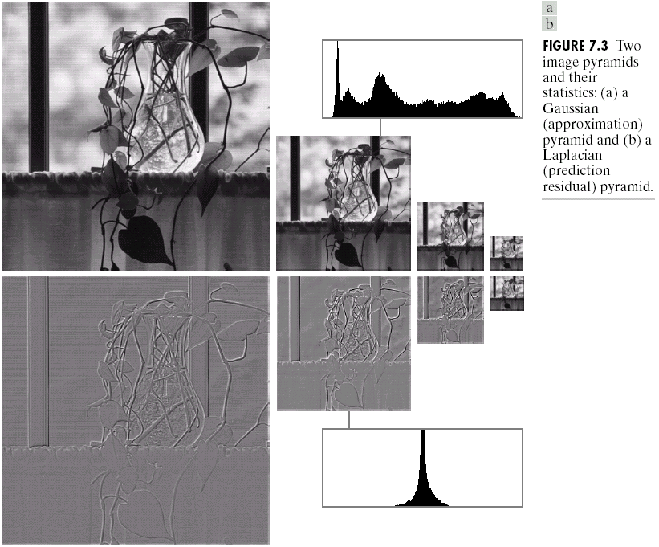
Image Pyramids

Slide 17
MULTIRESOLUTION ANALYSIS
In Multi-resolution Analysis (MRA), a Scaling Function is used to create a series of approximations of a function or image, each differing by a factor 2 from its nearest neighboring approximations. Additional functions, called Wavelet, are used to encode the difference in information between adjacent approximation.

Slide 18
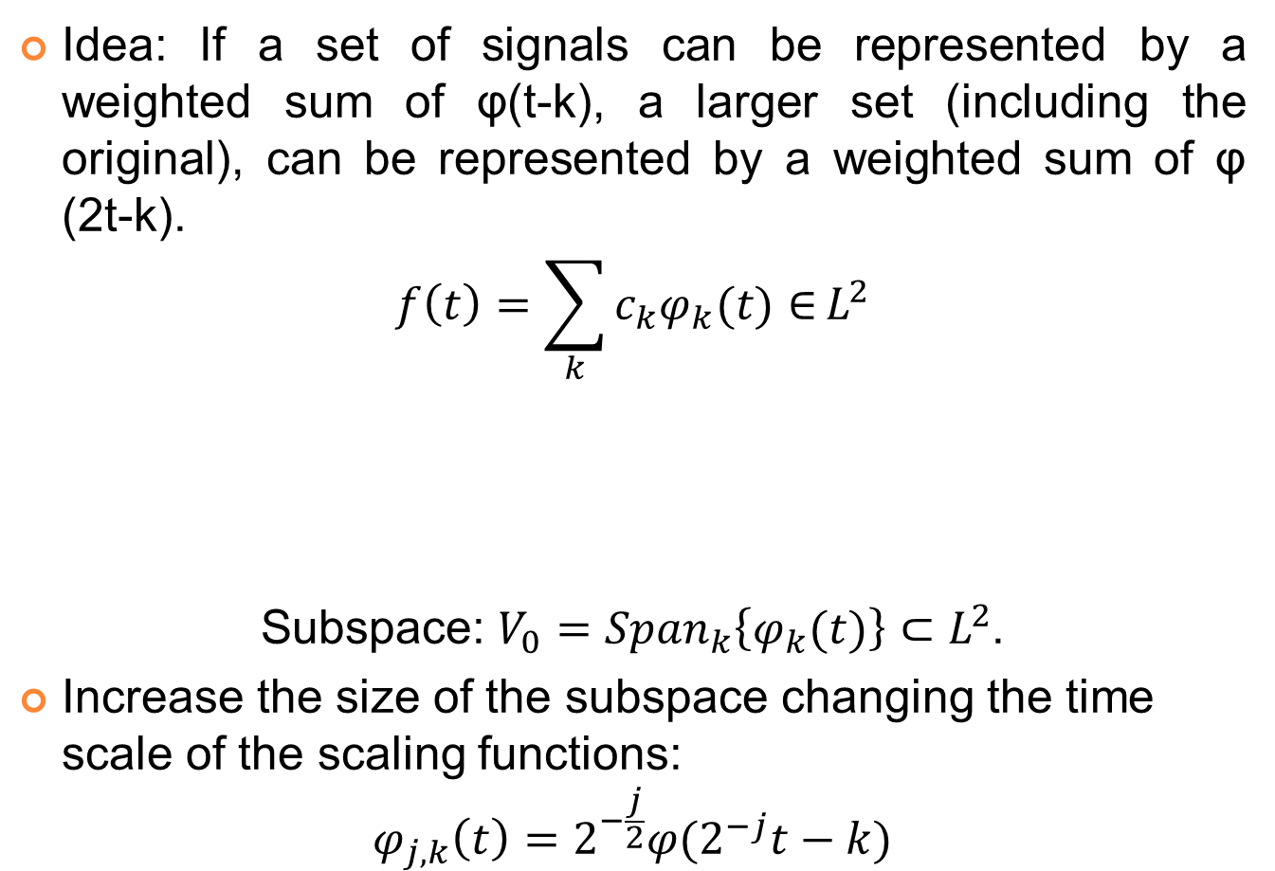
MULTIRESOLUTION ANALYSIS
Idea: If a set of signals can be represented by a weighted sum of φ(t-k), a larger set (including the original), can be represented by a weighted sum of φ (2t-k).
$$f\left(t\right)=\sum_{k}{c_{k}φ_{k}(t)∈}L^{2}$$
Subspace: $V_{0}={Span}_{k}\left\{φ_{k}(t)\right\}⊂L^{2}$.
Increase the size of the subspace changing the time scale of the scaling functions:
$$φ_{j,k}\left(t\right)=2^{−\frac{j}{2}}φ(2^{−j}t−k)$$
Real-valued expansion coefficients
Real-valued expansion functions

Slide 19
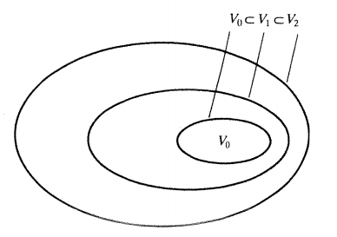

MULTIRESOLUTION ANALYSIS
The spanned spaces are nested:
$$V_{j}=Span\left\{φ_{k}(2^{j}t)\right\}=Span\left\{φ_{j,k}(t)\right\}∈L^{2}$$
$$V_{−∞}⊂…⊂V_{−1}⊂V_{0}⊂V_{1}⊂V_{2}⊂…{⊂V}_{+∞}$$
Wavelets span the differences between spaces w_{i}.
Wavelets and scaling functions should be orthogonal: simple calculation of coefficients.
Nested function spaces spanned by a scaling function

Slide 20
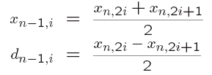
WAVELET TRANSFORM - EXAMPLE
Suppose we are given the following input sequence.
{x_{n,i}} = {10, 13, 25, 26, 29, 21, 7, 15}
Consider the transform that replaces the original sequence with its pairwise average x_{n−1,i} and difference d_{n−1,i} defined as follows:

Slide 21
WAVELET TRANSFORM - EXAMPLE
{10, 13, 25, 26, 29, 21, 7, 15}
10 | 13 | 25 | 26 | 29 | 21 | 7 | 15
11.5 | 25.5 | 25 | 11 | -1.5 | -0.5 | 4 | -4
18.5 | 18 | -7 | 7 | -1.5 | -0.5 | 4 | -4
18.25 | 0.25 | -7 | 7 | -1.5 | -0.5 | 4 | -4

Slide 22
WAVELET TRANSFORM - EXAMPLE
The averages and differences are applied only on consecutive pairs of input sequences whose first element has an even index.
The number of elements in each set {x_{n−1,i}} and {d_{n−1,i}} is exactly half of the number of elements in the original sequence.
Form a new sequence having length equal to that of the original sequence by concatenating the two sequences {x_{n−1,i} } and {d_{n−1,i}}. The resulting sequence is
{x_{n,i}, d_{n-1,i}} = {11.5, 25.5, 25, 11, −1.5, −0.5, 4, −4}

Slide 23
WAVELET TRANSFORM - EXAMPLE
This sequence has exactly the same number of elements as the input sequence - the transform did not increase the amount of data.
Since the first half of the above sequence contain averages from the original sequence, we can view it as a coarser approximation to the original signal.
The second half of this sequence can be viewed as the details or approximation errors of the first half.

Slide 24


WAVELET TRANSFORM - EXAMPLE
Synthesis: The original sequence can be reconstructed from the transformed sequence using the relations
Analysis (Haar wavelet transform)

Slide 25
WAVELET TRANSFORM - EXAMPLE
10 | 13 | 25 | 26 | 29 | 21 | 7 | 15
11.5 | 25.5 | 25 | 11 | -1.5 | -0.5 | 4 | -4
18.5 | 18 | -7 | 7 | -1.5 | -0.5 | 4 | -4
18.25 | 0.25 | -7 | 7 | -1.5 | -0.5 | 4 | -4
{18.25, 0.25, -7, 7, -1.5, -0.5, 4, 4}

Slide 26
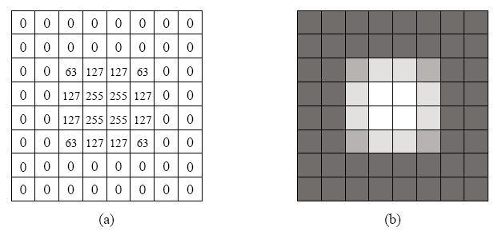
WAVELET TRANSFORM - EXAMPLE
Input image for the 2D Haar Wavelet Transform.
(a) The pixel values. (b) Shown as an 8×8 image.

Slide 27
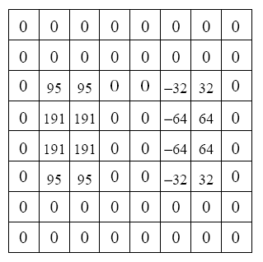
WAVELET TRANSFORM - EXAMPLE
Intermediate output of the 2D Haar Wavelet Transform.

Slide 28
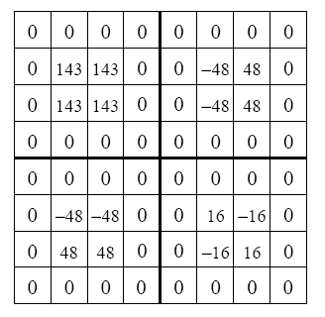
WAVELET TRANSFORM - EXAMPLE
Output of the first level of the 2D Haar Wavelet Transform.

Slide 29
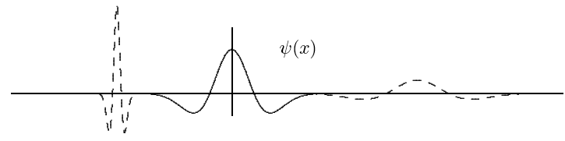

CONTINUOUS WAVELET TRANSFORM
Width of the window is changed as the transform is computed for every spectral components.
$$W_{x;ψ}\left(τ,s\right)=\frac{1}{\sqrt{\left|s\right|}}\int_{−∞}^{∞}{f(t)∙ψ^{∗}\left(\frac{t−τ}{s}\right)}dt$$
$τ$: translation (The location of the window)
$s$: scale
$ψ^{∗}$: mother wavelet

Slide 30
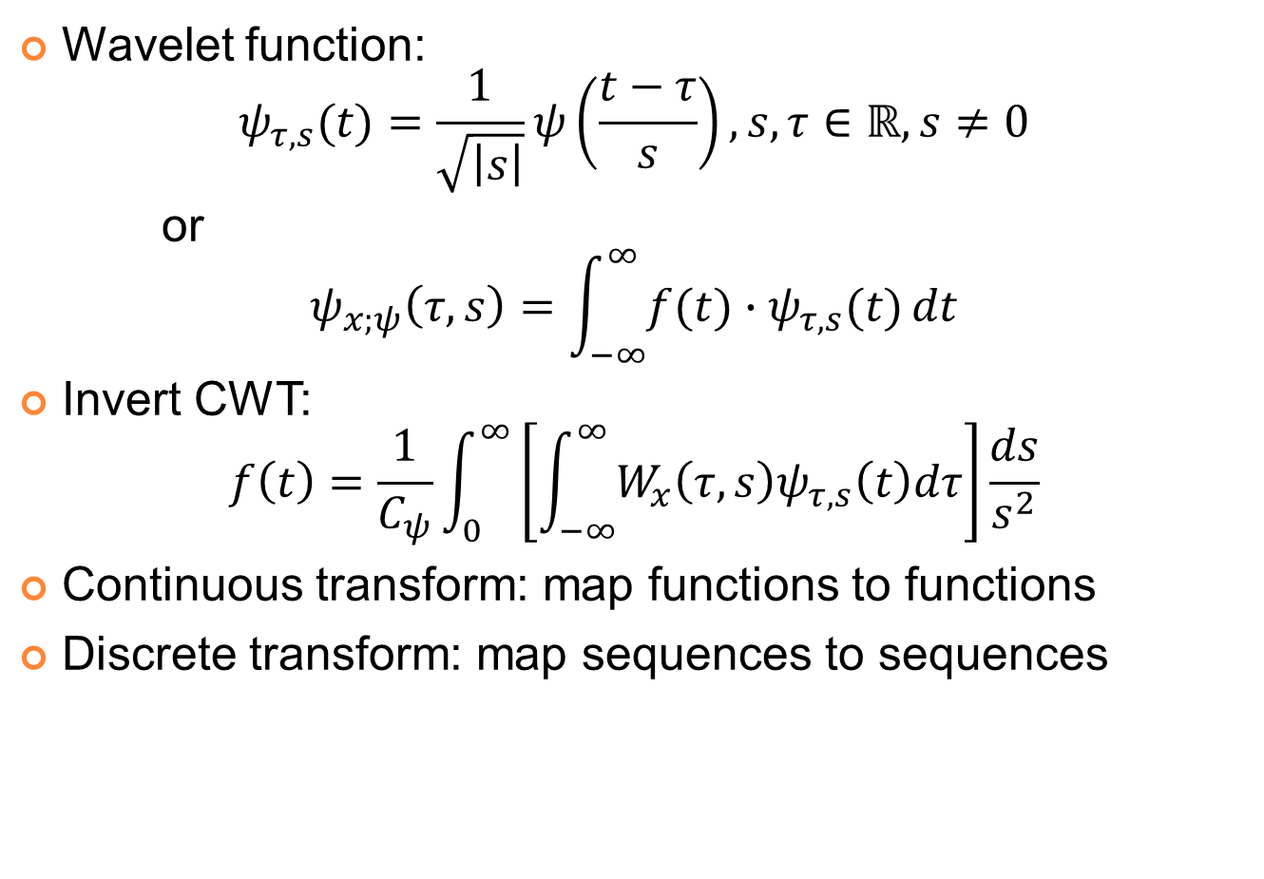
CONTINUOUS WAVELET TRANSFORM
Wavelet function:
$$ψ_{τ,s}(t)=\frac{1}{\sqrt{\left|s\right|}}ψ\left(\frac{t−τ}{s}\right), s,τ∈ℝ,s≠0$$
or
$$ψ_{x;ψ}\left(τ,s\right)=\int_{−∞}^{∞}{f(t)∙ψ_{τ,s}(t)}dt$$
Invert CWT:
$$f\left(t\right)=\frac{1}{C_{ψ}}\int_{0}^{∞}{\left[\int_{−∞}^{∞}{W_{x}\left(τ,s\right)ψ_{τ,s}\left(t\right)dτ}\right]}\frac{ds}{s^{2}}$$
Continuous transform: map functions to functions
Discrete transform: map sequences to sequences

Slide 31
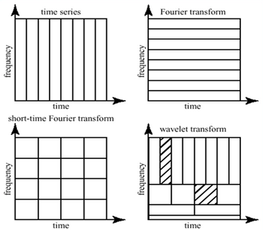
CONTINUOUS WAVELET TRANSFORM
Lát cắt tần số-thời gian của Biến đổi Fourier và biến đổi wavelet
From http://www.cerm.unifi.it/EUcourse2001/Gunther_lecturenotes.pdf, p.10

Slide 32
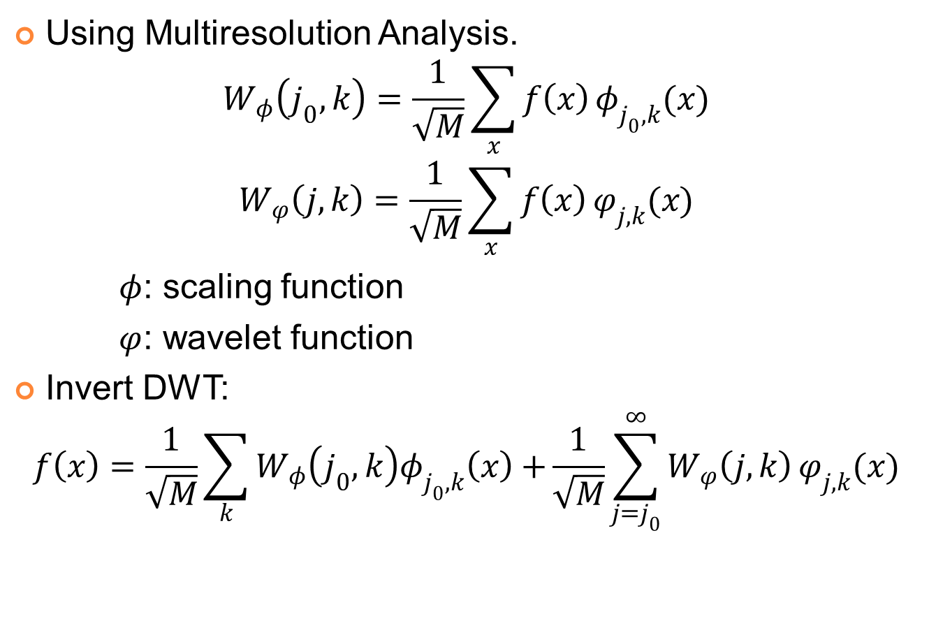
DISCREET WAVELET TRANSFORM
Using Multiresolution Analysis.
$$W_{φ}\left(j_{0},k\right)=\frac{1}{\sqrt{M}}\sum_{x}{f\left(x\right)}φ_{j_{0},k}(x)$$
$$W_{φ}\left(j,k\right)=\frac{1}{\sqrt{M}}\sum_{x}{f\left(x\right)}φ_{j,k}(x)$$
$φ$: scaling function
$φ$: wavelet function
Invert DWT:
$$f\left(x\right)=\frac{1}{\sqrt{M}}\sum_{k}{W_{φ}\left(j_{0},k\right)φ_{j_{0},k}\left(x\right)+}\frac{1}{\sqrt{M}}\sum_{j=j_{0}}^{∞}{W_{φ}\left(j,k\right)}φ_{j,k}(x)$$

Slide 33
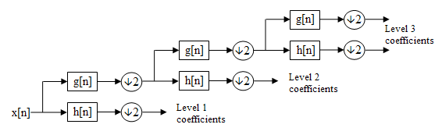
DISCREET WAVELET TRANSFORM
downsampling
DWT filter bank
g[n]: lowpass filter, scaling function
h[n]: highpass filter, wavelet function

Slide 34
DISCREET WAVELET TRANSFORM
Wavelet transforms
Low pass filtering: averaging
High pass filtering: differencing
Input data: a, b
Average: s = (a + b) / 2 (low pass filtering)
Difference: d = a – s (high pass filtering)
Wavelet coefficients: (s, d).
Inverse wavelet transforms: addition; subtraction
Wavelet coefficients: (s, d).
Addition: s + d = s + (a – s) = a,
Subtraction: s – d = s – (a – s) = 2s – a = b
Input data: (a, b).

Slide 35
DISCREET WAVELET TRANSFORM
Example: input data 14, 22
Wavelet Transform
Average: s = (14＋22)/2 = 18,
Difference: d = 14-18= -4
Wavelet coefficients: (18, -4).
Inverse Wavelet Transform (to recover the input data)
s ＋ d = 18+(-4) = 14,
s － d = 18-(-4) = 22
Input data: (14, 22).

Slide 36
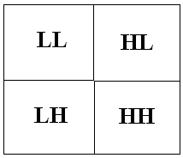
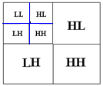
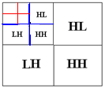
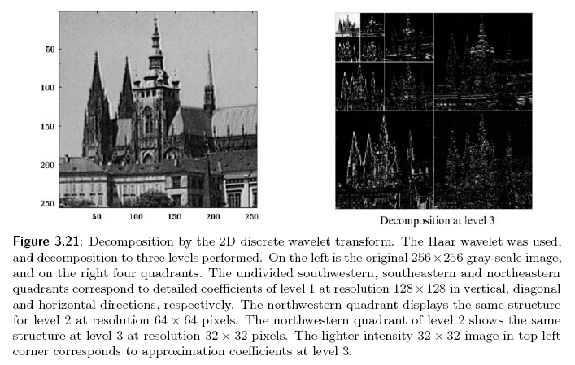
DISCREET WAVELET TRANSFORM

Slide 37
2D Wavelet Transform
For an N by N input image, the two-dimensional DWT proceeds as follows:
Convolve each row of the image with h₀[n] and h₁[n], discard the odd numbered columns of the resulting arrays, and concatenate them to form a transformed row.
After all rows have been transformed, convolve each column of the result with h₀[n] and h₁[n]. Again discard the odd numbered rows and concatenate the result.

Slide 38
2D Wavelet Transform
After the above two steps, one stage (level) of the DWT is complete.
The transformed image now contains four subbands
LL, HL, LH, and HH, standing for low-low, high-low, etc.
The LL subband can be further decomposed to yield yet another level of decomposition.
This process can be continued until the desired number of decomposition levels is reached.

Slide 39
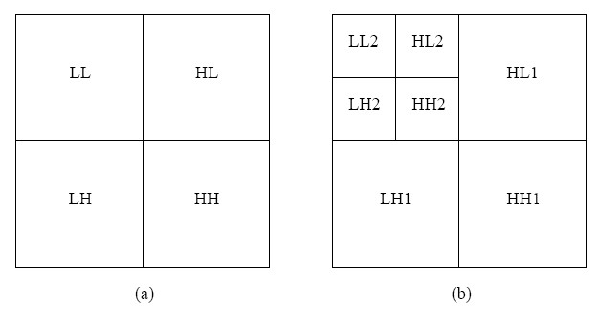
2D Wavelet Transform
The two-dimensional discrete wavelet transform
(a) One level transform. (b) Two level transform.

Slide 40
FAST WAVELET TRANSFORM
Basic idea of Fast Wavelet Transform
(Mallat’s herringbone algorithm):
Pyramid algorithm provides an efficient calculation.
DWT (direct and inverse) can be thought of as a filtering process.
After filtering, half of the samples can be eliminated: subsample the signal by two.
Subsampling: Scale is doubled.
Filtering: Resolution is halved.

Slide 41
FAST WAVELET TRANSFORM
Decomposition:

Slide 42
FAST WAVELET TRANSFORM
Decomposition:

Slide 43
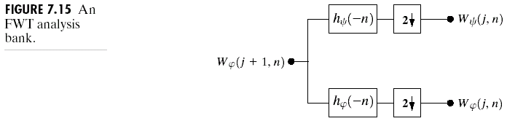
FAST WAVELET TRANSFORM
Decomposition:

Slide 44
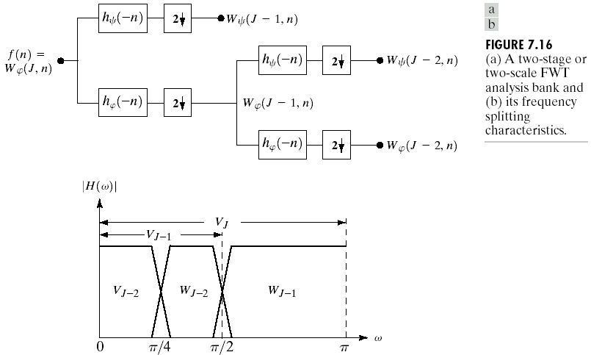
FAST WAVELET TRANSFORM
Decomposition:

Slide 45
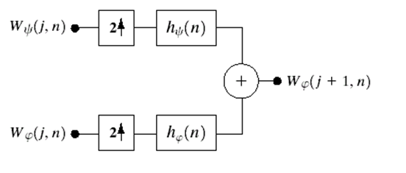

FAST WAVELET TRANSFORM
Synthesis

Slide 46
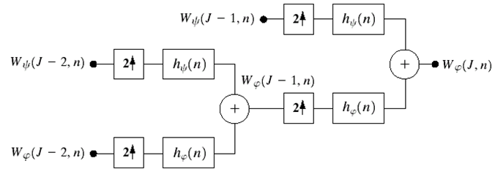

FAST WAVELET TRANSFORM
Synthesis

Slide 47
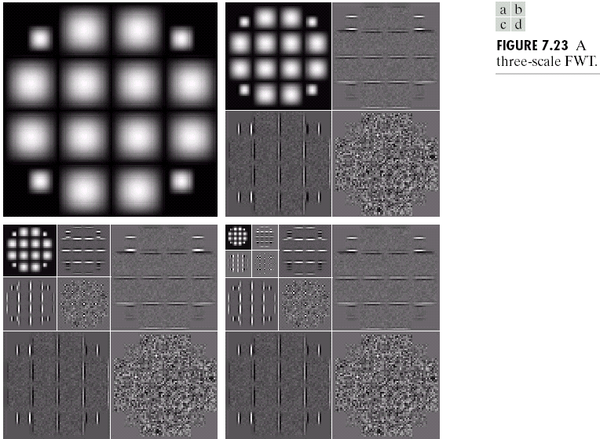
FAST WAVELET TRANSFORM

Slide 48
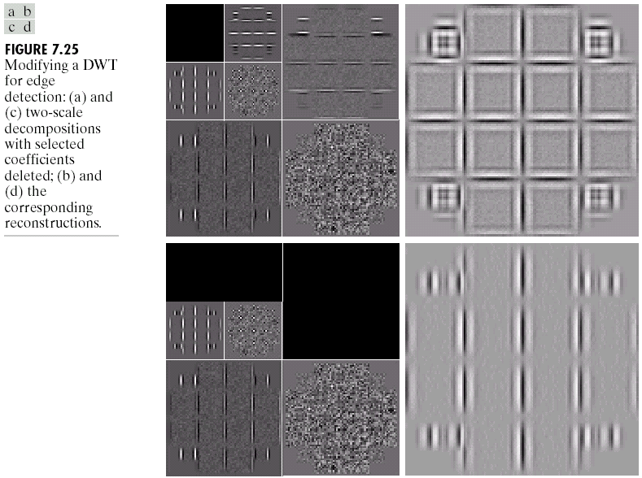
FAST WAVELET TRANSFORM

Slide 49
LIFTING SCHEME
The lifting scheme is an alternative method of computing the wavelet coefficients.
Advantages of the lifting scheme:
Requires less computation and less memory.
Linear, nonlinear, and adaptive wavelet transform is feasible, and the resulting transform is invertible and reversible.

Slide 50
LIFTING SCHEME
A spatial domain construction of bi-orthogonal wavelets, consists of the 4 operations:
Split : s_{k}⁽⁰⁾=x_{2i}⁽⁰⁾, d_{k}⁽⁰⁾=x_{2i+1}⁽⁰⁾
Predict : d_{k}^{(r)}= d_{k}^{(r-1)} – ∑p_{j}^{(r)} s_{k+j}^{(r-1)}
Update : s_{k}(r)= s_{k}^{(r-1)} + ∑u_{j}^{(r)} d_{k+j}^{(r)}
Scaling : s_{k}^{(R)}=K₀s_{k}^{(R)}, d_{k}^{(R)}=K₁d_{k}^{(R)}

Slide 51
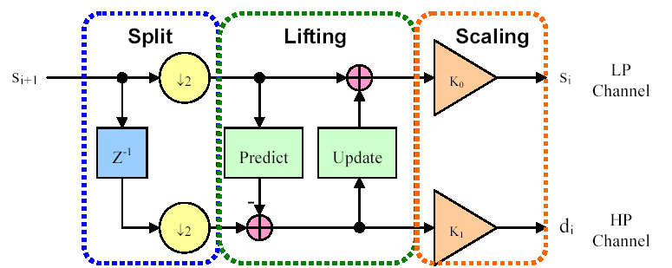
LIFTING SCHEME
A spatial domain construction of bi-orthogonal wavelets, consists of the 4 operations:

Slide 52
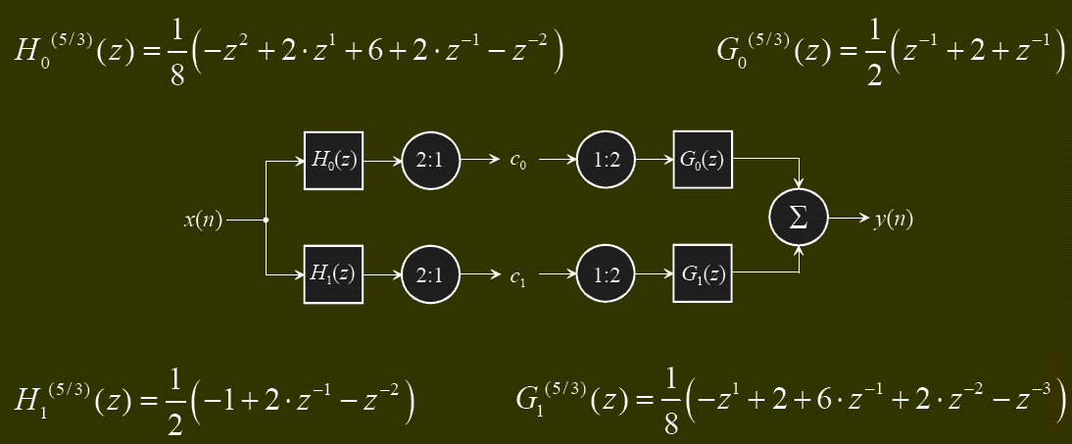
LIFTING SCHEME
Example: Conventional 5/3 filter
C₀ = (4*x[0]+2*x[0]+2*(x[-1]+x[1])-(x[2]+x[-2]) )/8
C₁ = x[0]- (x[1]+x[-1])/2
Number of operations per pixel = 9+3 = 12

Slide 53
WAVELET PACKET
In the usual dyadic wavelet decomposition (transform), only the low-pass filtered subband is recursively decomposed and thus can be represented by a logarithmic tree structure.
A wavelet packet decomposition allows the decomposition to be represented by any pruned subtree of the full tree topology.
The wavelet packet decomposition is very flexible.
The computational requirement for wavelet packet decomposition is relatively low as each decomposition can be computed in the order of N logN using fast filter banks.

Slide 54
WAVELET TRANSFORM APPLICATION
Compress image: JPEG 2000
Compress video
Compress speech/audio
Store digital Fingerprints
Fingerprints authentication
Reduce noise
Edge detection
…

Slide 55
DEMO
Haar wavelet transform
Compress image
Reduce noise
Wavelet transform on depth image
Wavelet transform on RGD-D image

Slide 56
REFERENCE
English:
M. Sifuzzaman, M.R. Islam, M.Z. Ali: “Application of Wavelet Transform and its Advantages Compared to Fourier Transform”, Vidyasagar University, 2009.
Rafael C. Gonzalez & R. E. Woods: “Digital Image Processing Third Edition”, Prentice Hall, ISBN 978-0131687288, pp. 483-543, 2006.
Richard Szeliski: “Computer Vision: Algorithms and Applications”, Springer, ISBN 978-1848829343, pp. 154-160, 2010.
Vietnamese:
Đỗ Ngọc Anh: “Nén ảnh sử dụng biến đổi wavelet và ứng dụng trong các dịch vụ dữ liệu đa phương tiện di động”, Đại học Bách Khoa Hà Nội, 2006.
Nguyễn Thị Lụa: “Nghiên cứu lý thuyết wavelet trong xử lý tín hiệu”, Đại học Bách Khoa Hà Nội, 2001.
Trần Duy Hưng: “Kỹ thuật xử lý ảnh sử dụng biến đổi Wavelet”.
Website:
http://en.wikipedia.org/wiki/Wavelet_transform
http://www.mathworks.com/help/wavelet/ug/wavelet-packets.html

